Slide 1
Behind The Curtains: The Internet
Learn all about the working of the internet, take a look at how it came to be and how to get started with Web Development

Slide 2
Table of contents
# 1
# 2
How The Internet Works
How The Web Works

Slide 3
Part 1: The Internet

Slide 4
Did You Know?
4.66 Billion
65.6%
44 Zettabytes
The Internet has 4.66B active users
Around 6/10 people have internet access
The amount of data present on the Internet
1 ZB = 1 Trillion GB

Slide 5
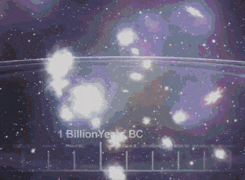
Behind The Curtains: The Internet
Let’s take a trip to the past and witness the birth of the internet

Slide 6
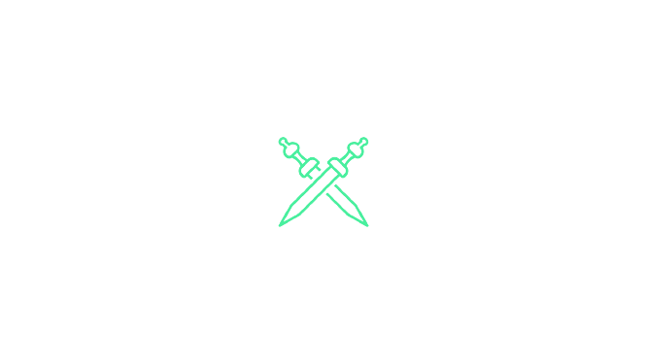

Setting the stage
The 1960s
The need to transmit information
Cold War tensions
were high
APARNET
INTERNET
Computers being bulky and immoblie
The Soviet Union just launched Sputnik
Notes:
Government researchers needed to transmit information
Computers were large and immobile → and in order to make use of information stored in any one computer, one had to either travel to the site of the computer or have magnetic computer tapes sent through the conventional postal system
Smack dab in the middle of the Cold War → tensions were high
The Soviet Union just launched Sputnik → information transmission was the need of the hour for the US
We know the why

Slide 7
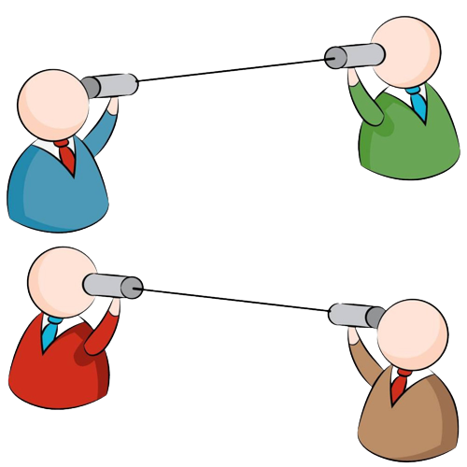
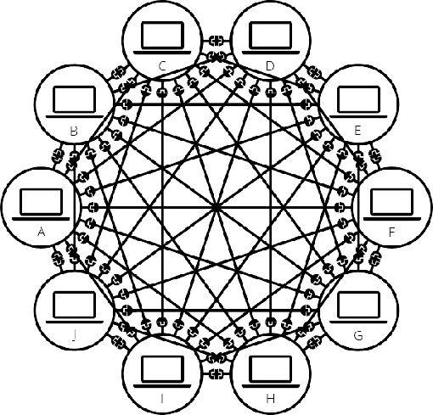
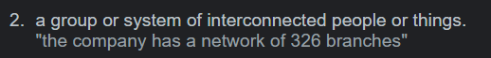

…what about the how?
Networks
Computers need a link between them to communicate
Simple network - 2 computers linked together
Network need have only 2 members

Slide 8
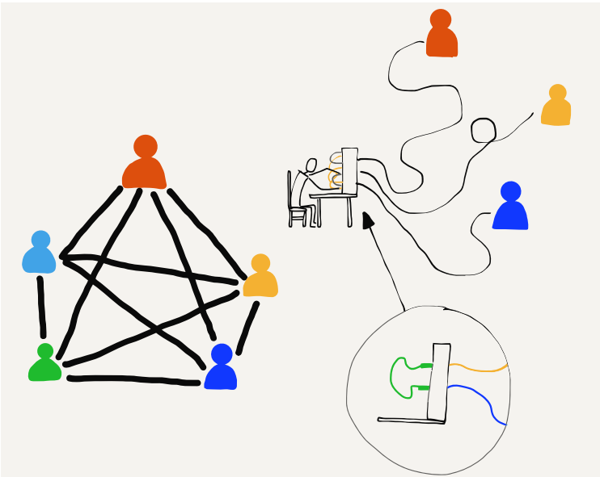
Routers, Modems and…Telephones?
Telephones and Telephone Operators
Group of people talking to each other –→ coordination and patience
Each person connected to one operator
Operator wold connect two people together
Operator would disconnect after call was done

Slide 9
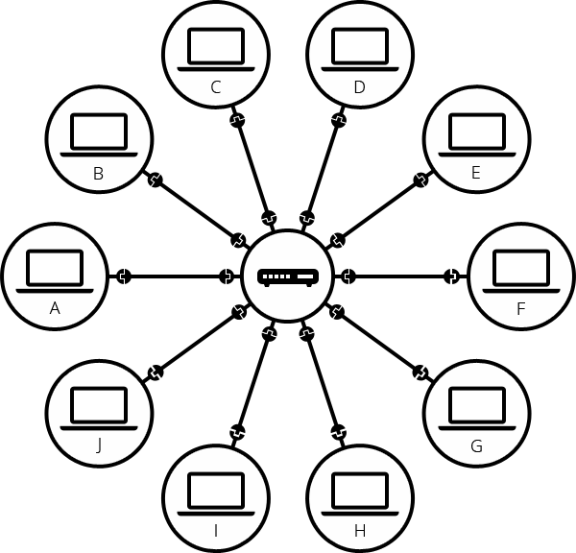
Routers, Modems and…Telephones?
Routers
Each computer is connected to a smaller computer: router
Serves the function of a telephone operator
DIrects message to right destination
Doesn’t direct to wrong destination either
Computer A
Router
Computer C
Computer B

Slide 10

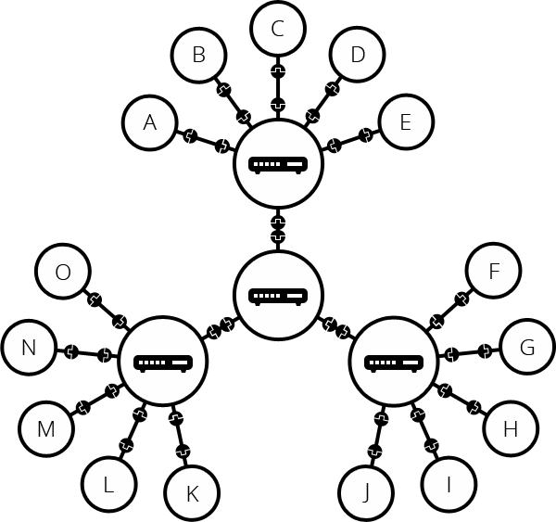
Routers, Modems and…Telephones?
A Network of networks
We’ve seen a few computers being connected
What about a 100? Thousands?
Full suitcase → what would you do?
Let another suitcase carry the load and take both
Similarly multiple routers can be assigned to take the load of many devices
Routers are computers too → can we connect them?

Slide 11
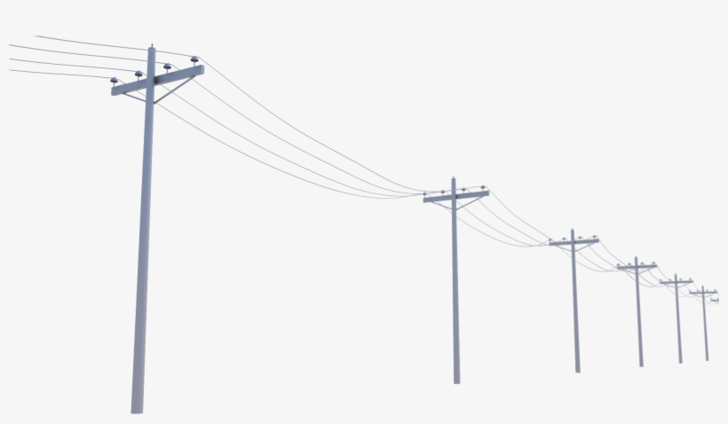
Routers, Modems and…Telephones?
Modems
Almost there → something’s still missing
It’s all been local till now, what about reaching the rest of the world?
There’s already something that lets us connect to the rest of the world
Computers
Modems
Telephone Lines

Slide 12
ISPs – The Google Maps for data
Internet Service Providers
A company that manages routers that themselves are linked together and to other ISPs
Message/data is carried through this network of ISP networks
Modems
Devices
Data
A connect infrastructure of networks
The Internet

Slide 13
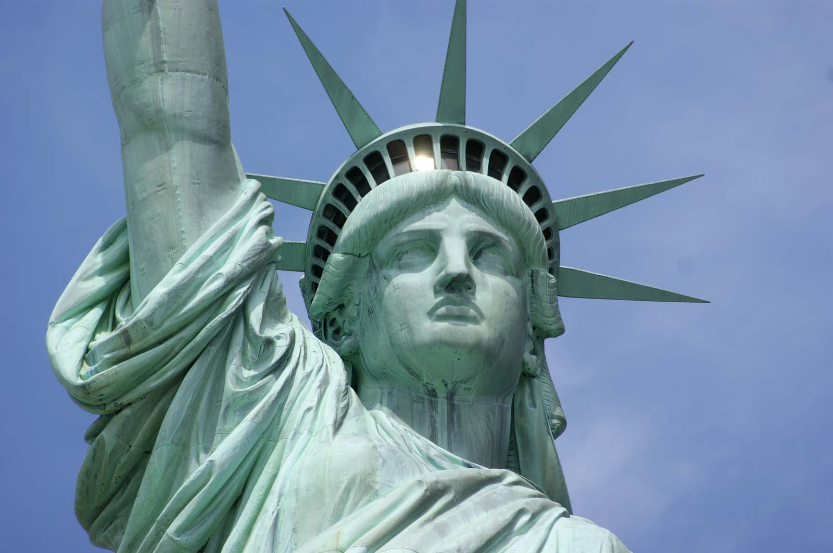
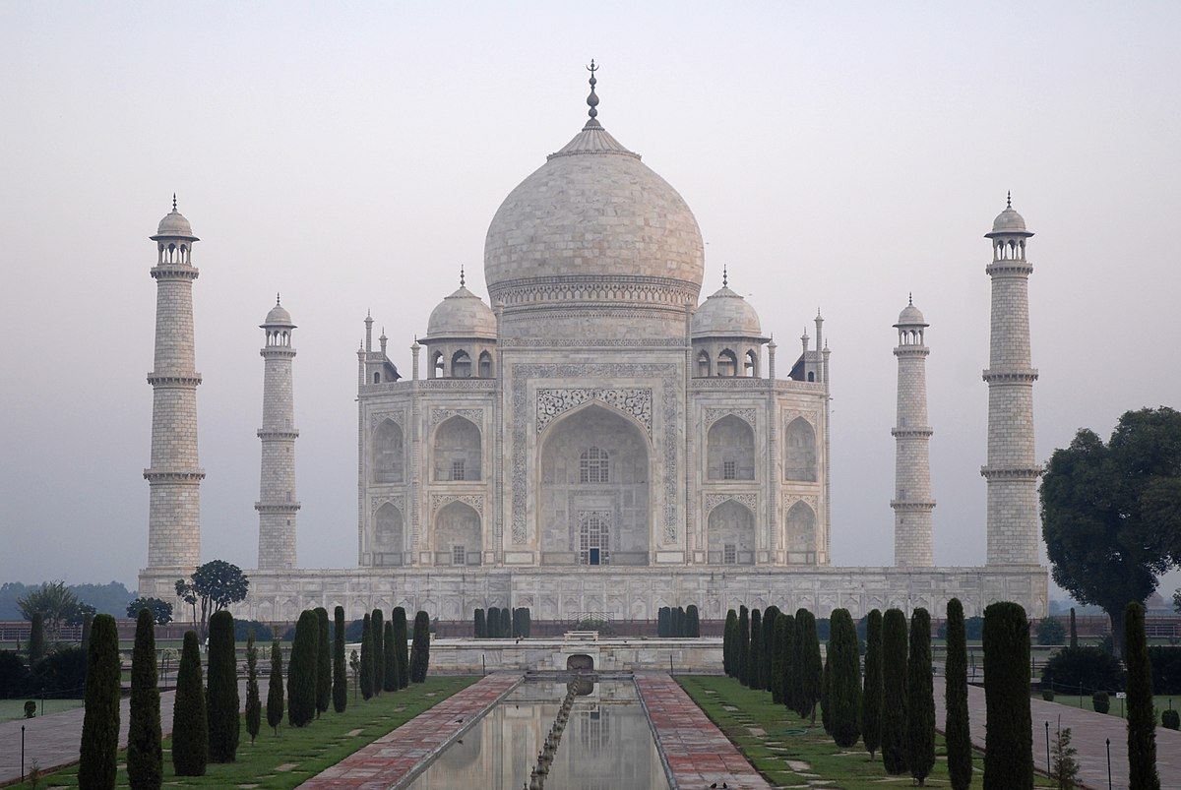
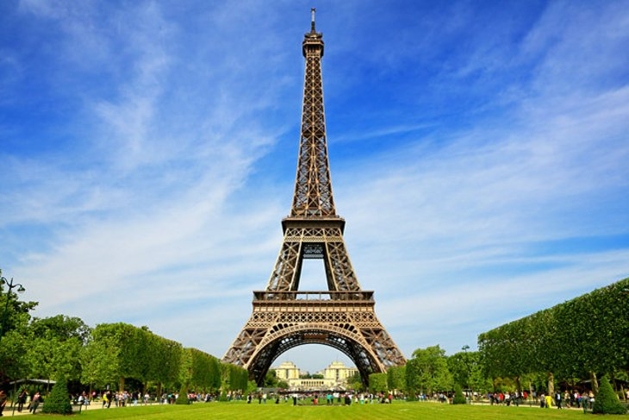
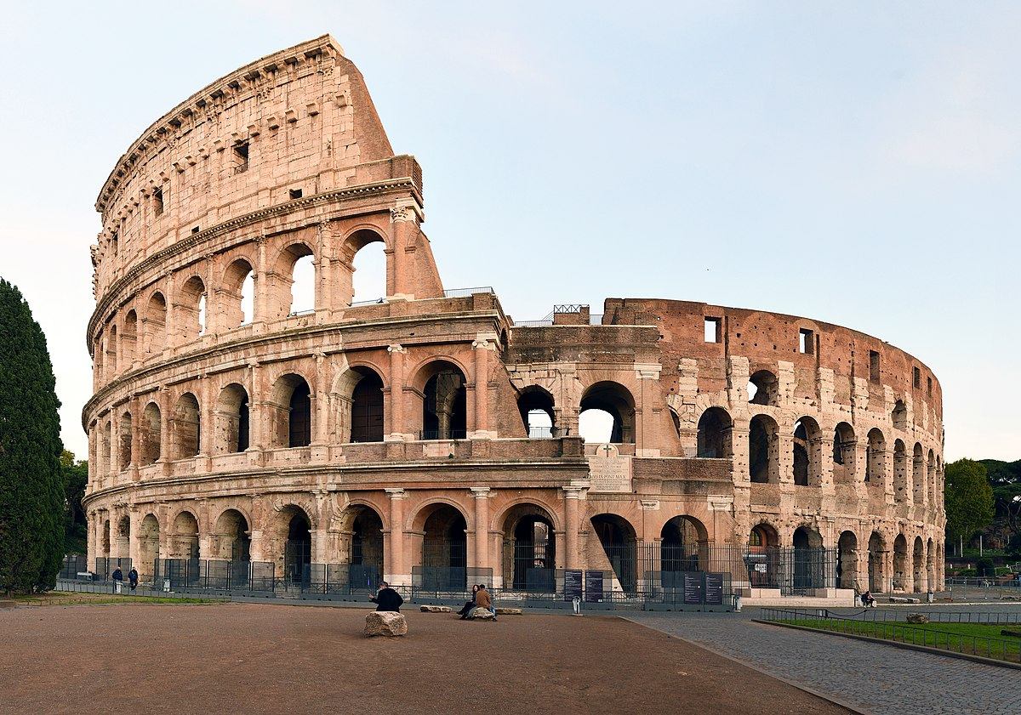
Can you guess these places?
Hint: 7 wonders of the world
40.6892° N, 74.0445° W
27.1751° N, 78.0421° E
48.8584° N, 2.2945° E
41.8902° N, 12.4922° E

Slide 14
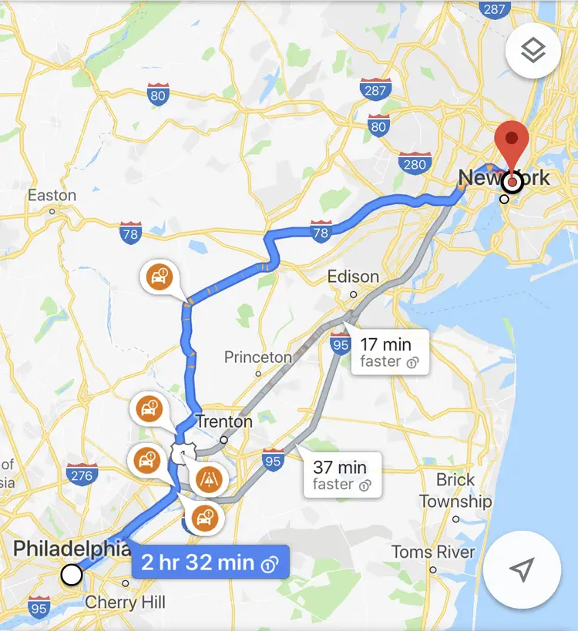
Finding Computers
IP Addresses and DNS
Data sent between a source and destination
Each computer has its own address - IP Address
IP stands for Internet Protocol
Analogous to locations in real life
Has its own format as well - 192.168.2.10
Humans can’t remember IP addresses - much like coordinates
Use an alias for the address - Domain Name

Slide 15
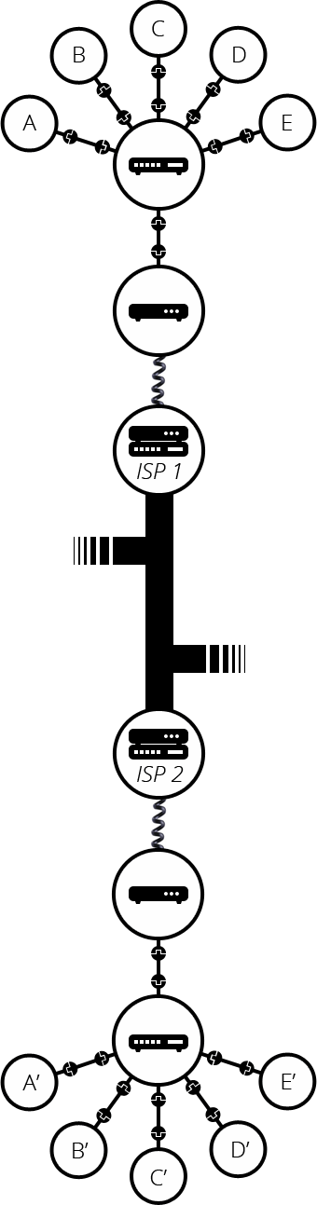
Half Of The Picture
Life of Datum

Slide 16
Part 2: The Web

Slide 17
Table of contents
#1
#2
#3
#4
Client-server architecture
Components of the web
DNS and Packets
HTML,CSS and Javascript : An overview

Slide 18
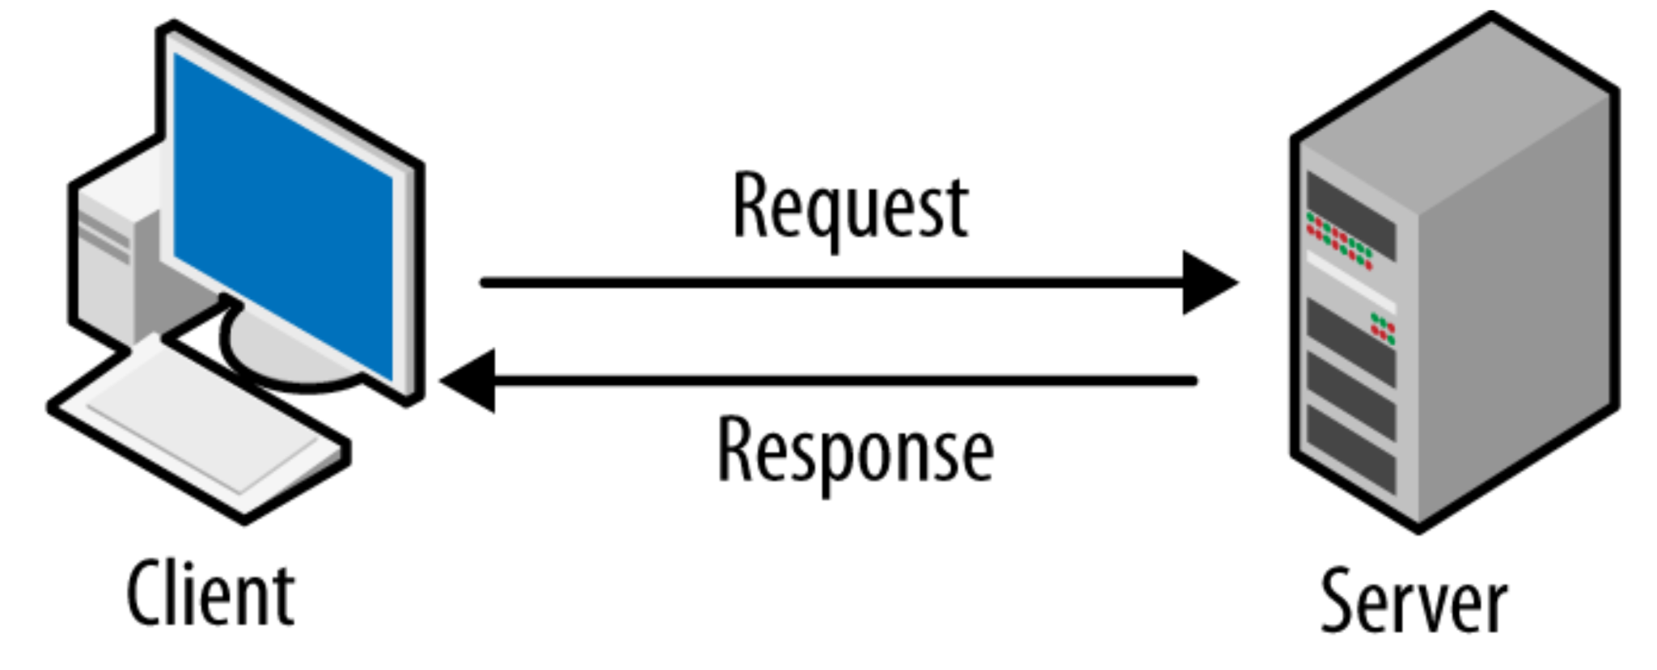
Client Server Architecture
Clients
Servers
How it works

Slide 19
Components of Web
Your internet connection
TCP/IP
DNS
HTTP
Component files

Slide 20
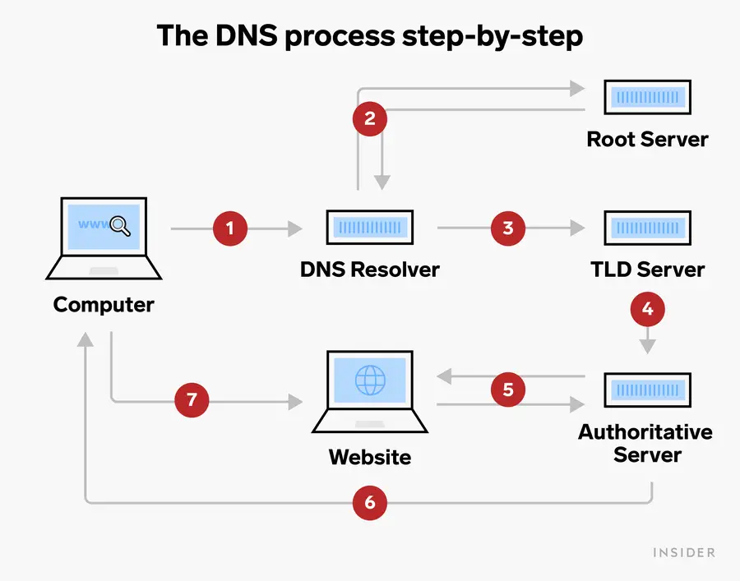
DNS (Domain Name System)
Networks
DNS basics
How DNS works
Types of DNS
Types:
Authoritative DNS
Recursive DNS
DNS use case and benefits
Intelligent traffic routing
High availability
Easy-to-use APIs

Slide 21
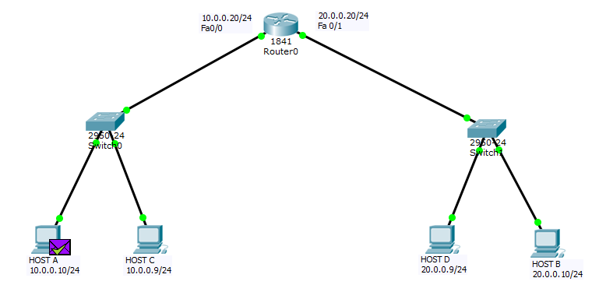
Packets
What is a packet?
Why is data divided into packets?
Disadvantages

Slide 22
HTML, CSS and JavaScript : An overview
HTML
CSS
JavaScript
CSS is used to control presentation, formatting, and layout.
It is used to control the behaviour of different elements.
It provides the basic structure of sites•

Slide 23
THANK YOU!

